Slide 1
Physical Wellness
EMERA EM resident wellness curriculum
Patrick Lank, MD, MS
Notes:
Good morning! Your talk today is going to be on physical wellness.
When I think of physical wellness, the image (and song) which pops into my head is this one from … (ask audience?) Chariots of Fire – 1981. Music: duh duh duh duh daaa dum... duh duh duh da dummmmm (etc)
But in this presentation we are going to speak about more than just exercise. We going to cover a few key topics which are particularly relevant to young adults doing emergency medicine training.

Slide 2
Today’s Talk
Notes:
To remind you, this is where today’s talk fits into the wellness curriculum. We have had some amazing sessions on social, spiritual, and occupational wellness; and we look forward to emotional and intellectual wellness discussions. But today let’s get physical (no pressure to make that joke ☺ )

Slide 3
Asynchronous Learning/III

Slide 4
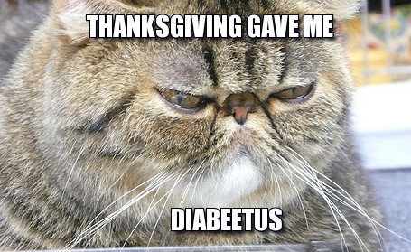
Physical wellness
Health
Sleep
Food
Exercise
Notes:
In this talk, I want to focus on 4 major topics in physical wellness – health, sleep, food, and exercise.
This is our roadmap for the talk. I’ll keep coming back to this slide, and I may or may not have a different cat meme every time.

Slide 5
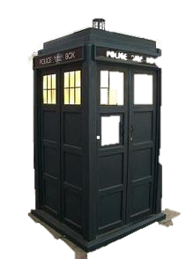
Medical Health
GO SEE A DAMN DOCTOR!
And a dentist.
Notes:
General health screening (well visit) is recommended for you every 1-3 years based on risk factors

Slide 6
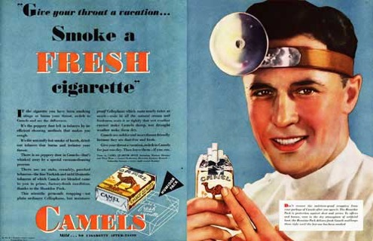
Medical Health
If you haven’t seen a doctor in a while:
Immunizations (usually not a problem for us)
Blood pressure screening
Height and weight
Cholesterol
Previous abnormal results?
HIV test?
Depression screening?
Dentists:
Oral cancer screening
Make teeth look nice
Notes:
You are doctors. You should know certain key answers – I don’t care how healthy you think you are:
What was your last in-office measured blood pressure? Was it normal?
How much do you weigh? What is your BMI?
Have you had your cholesterol checked? What are your numbers? The American Heart Association now recommends all adults over 20 have their cholesterol checked and discuss cardiovascular risk factors with their doctor at regularly scheduled intervals. The old recommendations were for this in adults over 35
Do you need diabetes screening?
Have you previously had abnormal tests that you’ve blown off because 1) you’re invincible, 2) you’re a doctor and a bad patient?
Do you need an HIV test?
Besides just cleaning your teeth and looking for cavities, dentists do oral cancer screening as part of their exam

Slide 7
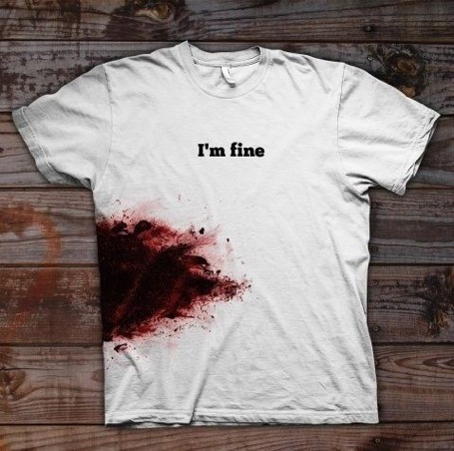
Medical Health
Advice:
Trusted referral
Never write your own prescriptions
Don’t blow things off because “I’m sure it’s fine”
Take your medicine
When seeing doctors, admit you are a doctor.
It’s fine.
But don’t be a jerk about it.
Notes:
Here are some of my pieces of advice from dealings with doctors as a patient (faculty: insert your own if you have others)
PMD referral from someone you know/trust/like
Never ever write your own prescriptions. In most of your institutions, that will be explicitly not allowed for residents. Don’t do it.
Don’t blow off real things. Do you need to see a doctor when you have a cold? No. But that progressively worsening RLQ pain with anorexia? Yes.
Take your medicine. Simple, I’ll say it again. Take your medicine.
When I see doctors, I try to let them know I am a doctor relatively early on in the interaction. For everyone who has practiced for a few years, it is always perfectly fine. I am never upset when patients tell me they are a doctor (unless they aren’t) – it makes the interaction much more efficient. But don’t be a jerk about it.

Slide 8
“Do you have a primary care doctor?”
Answer “yes”: “How did you choose your doctor?”
Answer “no”: “Why not?”
Notes:
2 minute break:
Advise residents to turn to person sitting next to them to ask if they have a primary care doctor.
After you are done, ask if anyone is willing to share why they do not have a PMD. Then offer advice based on their response.
Insurance issues: offer to have your housestaff representative discuss with them their concerns
Privacy concerns: does your housestaff group have a policy for physicians at your institution?
Time: are there primary care groups in your area open during off hours?

Slide 9
Sleep
IT IS IMPORTANT!!
Notes:
Patient safety:
Sleep deprivation causes amongst resident physicians: increased tolerance for risk, passivity and avoidance of effort, decreased cognitive function, and psychomotor function comparable to alcohol intoxication, and greater dangerous medical complications
Resident safety:
- Sleep deprivation causes incr dangerous complications (e.g., needle sticks)
Incr risk of car accidents

Slide 10
Notes:
There are quite a few tools to help you identify your level of sleepiness.
In reality, I bet if I just asked all of you how sleepy you all were, you’d say something like, “Uh, I’m pretty sleep I guess” or “I’m super sleepy” and you’d be right.
But this formalizes that with the scoring system listed on the EMERA website.

Slide 11
Sleep: Night Shifts
They’re not awesome for you
You still need sleep
Notes:
There’s a lot published about night shifts, their effects on sleep and our overall health. That is a whole lecture on its own.
But they’re a reality of our jobs. So try to be healthy about them.
You still need 8 hours of sleep in a 24 hour period. That is a constant.
How you get those hours is up to you. Big tips:
Routine physical fitness aides your ability to adapt to different sleep schedules
Do not ingest caffeine within 4 hours of attempting sleep
Avoid alcohol
Melatonin may work for some
Cool and dark environment is best
Sleep anchoring?

Slide 12
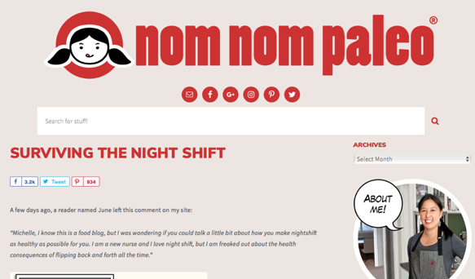
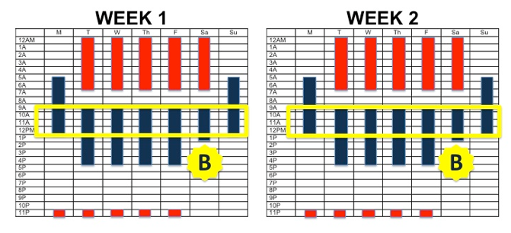
Sleep: Night Shifts
Resources:
- Sleep Anchoring (link on EMERA website)
- Black out systems
- Funny blogs
Notes:
There are a TON of resources for dealing with night shifts. They are widely varied. But here are a few I find particularly interesting and helpful:
Sleep anchoring. Basically this is the idea that if you are on a string of nights, you have a set-aside block of time during which you are always sleeping. You have a bit of flexibility to start your nights, but that block is a constant. The link for more details is on the EMERA website
I LOVE my blackout blinds. There are lots of systems of various cost out there. But as soon as you make money, please stop using trash bags over your windows. They’re not cute.
Finally, this is a blog with quite a bit of great advice for people who go in/out of nightshift work. Take a look if you have a minute. Website: nomnompaleo.com

Slide 13
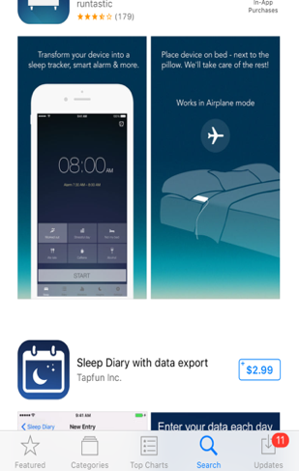
2 minutes
How many hours have you slept in the last 3 days?
Do you have symptoms of sleep deprivation?
Notes:
In this mini break, introduce the idea of sleep trackers with that as one of the III credits – use for 2 weeks.

Slide 14
Food
Intro diet stuff
Cat meme
FOOD
Notes:
Alright. Now let’s talk about one of my favorite subjects – food.
We as emergency physicians are not the greatest about talking with our patients about food. Our eyes glaze over when a very nice patient painstakingly describes their diet for the 48 hours before the onset of their chest pain.
But, should we do it more? And how do our life choices influence patients’?
They’ve studied it a bit:
One study (Archives of Family Medicine) showed that physicians who spoke with patients about diet and exercise and included their own personal health habits were 1) more believable, 2) more motivating.
Another (Archives of Internal Medicine) showed that physicians who have healthy personal habits are more likely to discuss them with their patients.
And outside of patient case, we know that eating health improves general health, sleep, and desire to exercise. In essence, what this entire wellness talk is about!
So on this first food slide, I am showing you a general recommendation on the approach of choosing fruits and vegetables – “Eat a Rainbow.” Don’t just eat green things – eat lots of colors.

Slide 15
MyPlate
Current USDA Food Guide
Encourages variety
Decent online resources
Notes:
In 2011 the USDA change its food guide symbol to this – MyPlate (from the famous food pyramid)
Graphically it’s giving estimations on portion sizes per meal but also emphasizing that each meal should have a variety of nutrient sources. Again, that you should eat a rainbow.
If you go to choosemyplate.gov, there are also a decent number of resources for ways to make your diet healthier – discussion on the use of calories, current thoughts on sugar, sodium, etc. As well as games for tracking your nutritional intake.

Slide 16
Food
Fads don’t work
There’s no “evil” food
Find dietician slides – good meals at national chains?
Notes:
Really my take-aways from everything the USDA says are: fad diets don’t work (and may be dangerous); there are no “evil” foods.
Current recommendations focus on expanding your horizons and trying different forms of similar foods:
Include lean proteins in your diet.
Add variety to your fruits and vegetables (again!)
Increase fiber intake
Choose healthy fats (more on this in a second)
Limit added sugar – also known as, ”there’s no need to eat ’low fat’ everything, because that tends to be high in sugar/salt”
Consume alcohol and caffeine in moderation
Focus on proper portion sizes

Slide 17
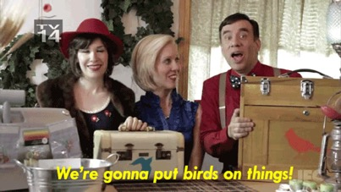
Fiber
Instead of Eating This: | Eat This:
Corn flakes | Oatmeal
Apple juice | Apple
Omelet | Veggie omelet
Hamburger | Veggie burger
Chili con carne | Chili w beans, vegetables, etc.
Rice | Quinoa or barley
Pretzels | Popcorn
Throw some berries on it
Throw some veggies on it
Credit: Kelly Wicklander, RD, LDN, CNSC
Notes:
These next 3 slides are going to be some potential easy interventions for you to take away from this lecture.
First, Increase your daily fiber intake.
Apparently most US adults eat about half the recommended amount of fiber
Health benefits include: heart disease prevention (I’m looking at you, night shift workers), improving glycemic control, aiding in digestive health, and creating satiety.

Slide 18
Fat Intake
Skip | Swap in
Cheese (ummm… no) | Avocado and nuts (well these are pretty good)
Sour cream | Plain greek yogurt
Butter | Nut butters, olive oil, grapeseed oil
Half & half | Nut milk, whole milk (?)
Mayonnaise | Avocado, Laughing Cow Cheese Spread, hummus
Restaurant sauces/aioli | Hot sauce
Ranch dressings | Bolthouse Farms yogurt dressings
Cream cheese | Laughing Cow Spread
Credit: Kelly Wicklander, RD, LDN, CNSC
Notes:
2. Rethink what kinds of fats you are taking in.
Now this slide is perhaps a bit more controversial. Are there really better fats than others? Maybe not, but the options in the R hand column include fats you can ingest more of and still add variety to your diet.
There is no way I’m excluding cheese from my diet. And greek yogurt isn’t the cure to all my problems in life, but will I start thinking about using some of these? Probably.

Slide 19
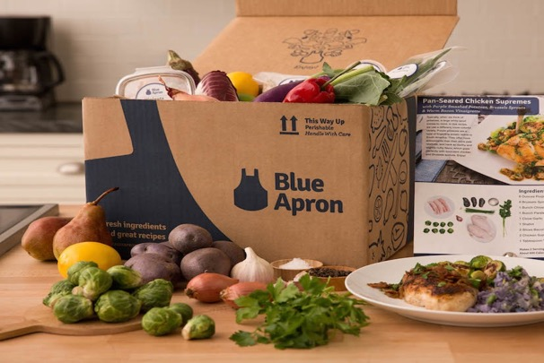
Food
Notes:
A third general recommendation is that you make your own food. At least sometimes. Bring it to work. Cook at home on your night off. It’s so much better for you!
But with our busy schedules, meal planning, shopping, and preparation takes a long time. Look into some meal delivery services – some deliver prepared meals which need to be heated up, others provide you with groceries and a recipe for meals that take 30 minutes to prep. I use Hello Fresh and recommend it.
Alternatively, if you’re not into being told what to do, there are grocery delivery services such as instacart, shipt, and wegoshop that will deliver your groceries to you.

Slide 20
2 minutes
If you have a favorite recipe or cooking website, share it with your neighbor.
Notes:
Faculty, think about sharing your favorite recipe. Or your favorite cooking tip/technique.
I’ll share that I have a bookmark tab for my favorite online recipes. And if I have time, a favorite recipe.

Slide 21
Exercise
The EM stereotype
Why else should I?
But I don’t have time
Side thoughts: what exercise is this? Where did she jump from? Why?
Notes:
Finally, I want to talk to you all about exercise.
First of all, this is what every other specialty thinks we do all the time. We are not the golfers. We are the mountain climbing, hiking, kayaking triathletes in the hospital. But what if that isn’t you? You chose the specialty because you love the work, not because you thought the stereotype was cool.
So, we all know that it’s good for us, but why?
On the EMERA website is a link to the mayoclinic’s “7 benefits of exercise.” Here they are:
- Controls weight
Combats multiple diseases
Improves mood
Boosts energy
Promotes better sleep
Improves sex drive
And is enjoyable
But what do you have time for as a resident?

Slide 22
Ballpark estimates
150 minutes/week moderate
OR
75 minutes/week vigorous
Notes:
General recommendations are a minimum of 150 minutes/week of moderate intensity exercise or 75 minutes per week of vigorous
Try a combination of things for 1) enjoyment, 2) injury prevention
Include strength training
Increase goals if focusing on weight loss

Slide 23
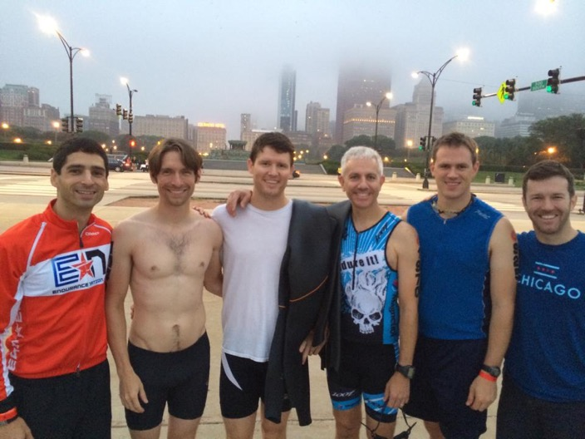
Exercise
Chicago Triathlon 2015
Attending
Attending
Resident
Resident
Attending
Attending
#2 behavior assoc w well-being
Residents do it less than attendings
Make it part of your program
Notes:
After adequate sleep, exercise is the #2 behavior associated with reisdent physician well-being
It has been shown that residents exercise on average 50% less than their attendings (regardless of specialty)
Some themes in a qualitative study on resident physician exercise:
Know that there are different barriers to exercise based on the individual – trends in residents: access to equipment, time; trends in attendings: age-related injuries, family time
Residents who are frustrated by their inability to exercise are at risk for developing an adversarial relationship with exercise
”Fixes”: 1) Focus on short periods of more frequent exercise – bike to work, run after conference, etc. 2) Develop a workplace “exercise culture” -- email the residency to arrange social interaction around a race, volunteer at races, build sports teams in your city.

Slide 24
2 minutes
What do you like to do for exercise?
Do you know anyone who likes to _(whatever your favorite is)__?
Notes:
Final 2 minute break.
Turn to neighbor
What do you like to do for exercise?
Do you know anyone who likes to ___?

Slide 25
Summary
Get a doctor
Sleep
Eat well
Exercise
Notes:
Essentially this talk was just advising you to do what your parents tell you to do.

Slide 26
What’s coming next

Slide 27
Individualized Interactive Instruction (III) Assignments (to be completed in October):
1. Read the article: Special Report: Who Lives, Who Dies, Who Tells Your Story? The Magic of Narrative Medicine in the ED. Shaw, Gina Emergency Medicine News. January 2017 - Volume 39 - Issue 1 - p 20–21 (30 minutes credit)
2. Journal: about a challenging case or interaction. What did you learn from the experience, how will it shape how you practice moving forward? (one hour credit)

