Slide 1
Occupational Wellness
Elise Lovell, MD
Advocate Christ Medical Center

Slide 2
Notes:
A quick recap for our new interns…

Slide 3
Notes:
Burnout, the triad of emotional exhaustion, depersonalization, and low personal accomplishment, is common in physicians and the incidence is rising.
As of 2017, nearly 60% of emergency physicians feel burned out. Emergency medicine is number one for burnout among specialties surveyed (Medscape survey of >14,000 US physicians). ^{1,2} Burnout has significant career implications, as it increases the likelihood of medical error, decreases career satisfaction and longevity, and is associated with physical and mental illness and substance abuse.

Slide 4
Notes:
Wellness is not simply the absence of burnout. Wellness requires active, ongoing, lifelong effort. A holistic approach to wellness crosses six commonly cited dimensions: Social, Spiritual, Occupational, Physical, Emotional, and Intellectual.³
A national collaboration of EM educators has created and is implementing a one year EM residency wellness curriculum. This is the third of six lectures, and there are additional III assignments and resources located on the website emera.network.org. We will plan to catch up the new interns over the next 1-2 months. (The mission and vision statements are on the slide)

Slide 5
Work Life Balance vs Work Life Integration
Notes:
Why focus on Occupational Wellness?
We spend a lot of time at work. We all started this journey with a feeling of purpose, meaning, gratitude, and excitement. With every patient in the ED, we have the chance to care; with some, the chance to cure; and occasionally, the chance to save a life. Somewhere along the way though, “work-life balance” became the buzz-phrase. This implies a tension between work (bad) and life (good) that needs to be resolved in order to find happiness. Instead, consider the concept of “work-life integration.” This has caught on in the business world, where technology blurs the boundaries of office and home, and working remotely is increasingly common. There is a also a more humanistic interpretation of work-life integration, which promotes the synergies between all components of life, including our work. If our work is meaningful and brings joy, if we are driven by purpose and passion, then time in the hospital, and even contributing to rewarding medical activities outside of the hospital (EMS, education, community engagement), feed our spirit instead of causing frustration and a fear of missing out.⁴
(Wonder Woman, alter ego Diana Prince. Stands for Truth and Love.)

Slide 6
System Contributors to Burnout
Bureaucracy/inefficiencies
Loss of autonomy
EHR
Feeling undervalued/diminished by Administration
Notes:
It’s recognized that a number of systems issues at work contribute to physician burnout: bureaucracy, loss of autonomy, the EHR, feeling undervalued and diminished by administration. Reclaiming autonomy and control of your workplace by becoming involved in operations, quality improvement, or through joining hospital committees to effect change, can all improve occupational wellness. This engagement can start during residency.
Discussion: how are your residents currently engaged in change, plant seed for future engagement at your shop.

Slide 7
Getting Personal
Notes:
But let’s dig deeper, to factors under our direct control that chip away at our occupational wellness and impact the depersonalization component in the triad of burnout.
Depersonalization is the psychological withdrawal from relationships, and the development of a negative, cynical, and callous attitude, otherwise known as compassion/empathy fatigue.
In other words, how do we retain our humanism as physicians?
We’ll discuss some specific strategies….
(“Depersonalization” art installation, Kiev)

Slide 8
1. Compassion Role-Models
To be or not to be empathic: the combined role of empathic concern and perspective taking in understanding burnout in general practice. Lamothe M,BMC Family Practice 2014
Notes:
Who is your compassion role-model? Seek out the Tiggers at work. Who seems to consistently keep a positive outlook, speaks warmly of their patients, expresses gratitude for being a doctor? Learn their secrets. Some tips I’ve taken away: bring a sandwich or a warm blanket to a patient/family member-it’s an exchange of humanity. Ask the elderly couples how long they’ve been married, and see them light up. Ask about a patient’s job. Use touch to connect and express respect-shake everyone’s hand. Appropriate humor goes a long way towards calming anxiety-it’s good to listen to or offer a joke. In the charting room or on the phone, refer to patients by name, not room number or diagnosis. When studied, higher physician empathy and the attempt to take into account the perspective of the patient have been associated with decreased levels of burnout.⁵
Discussion-how do residents/attendings in audience connect with their patients? Who are the Tiggers at your program?

Slide 9
2. Your Patients Are Not Your Enemies
Notes:
Your patients are not your enemies. The battle of patient versus doctor was epitomized in the anger and resentment of The House of God, written under by the pen name Samuel Shem by author and psychiatrist Stephen Bergman.⁶
Over the past three decades, Bergman has been dedicated to speaking about “Staying Human in Health Care.” He emphasizes the power of connection, both in medicine and in personal relationships; empathy; speaking up against wrongs in the medical system; and nurturing a global sense of community.

Slide 10
3. Foster Social Resilience
The Missing Link: Connection Is the Key to Resilience in Medical Education. McKenna KM,. Acad Med 2016.
Notes:
Foster Social Resilience. We’ve talked previously about resilience as the ability to adapt in healthy ways to adversity, to act and react with optimism; bouncing back from setbacks or failure. Resilience is closely tied to wellness. It requires self-knowledge, flexibility, motivation, and especially relationships.
Social resilience is the capacity of a group to endure stress in a positive way, through bonding and reliance. Beyond our personal connections, we talk of our “tribe” of emergency physicians. Trusting ourselves to be vulnerable to share bad cases, doubts, and errors makes us stronger.⁴
(Navy SEAL training)

Slide 11
4. Coping With Medical Error
Notes:
Perceived medical error can be emotionally devastating, and the culture of medicine historically is founded on perfectionism, never showing weakness, and assigning personal blame for error.

Slide 12
Coping With Medical Error
Talk about the event
Personal forgiveness
Acknowledge imperfection
Teach about the mistake
Wisdom in Medicine: What Helps Physicians After a Medical Error? Plews-Ogan. Acad Med 2016.
Notes:
After a medical error, positive coping mechanisms include talking about the event, personal forgiveness, acknowledging imperfection, and teaching about the mistake-all strategies facilitated by strong social resilience.⁷
Personal distress and decreased empathy are also associated with increased future risk of medical error, suggesting a cyclic nature to distress, empathy, and error.⁸
Discussion: What personal/program strategies do you use to help cope with medical error?

Slide 13
5. Develop a Growth Mindset
Notes:
Based on the work of Stanford Professor of Psychology Carol Dweck and her book Mindset: The New Psychology of Success.⁹
Concept that people have beliefs about learning and intelligence that can be categorized as “Growth Mindset” and “Fixed Mindset.”
People with a Fixed Mindset believe that intelligence is static. They therefore avoiding challenges, view effort as a waste, feel threatened by success of others, and respond poorly to feedback.
People with a Growth Mindset believe that intelligence can be developed. Therefore they embrace challenge, work to overcome obstacles, view effort as part of the path to excellence, learn from feedback, and see lessons/inspiration in the success of others.
Easy visual explanation: https://www.mindsetworks.com/Science/Impact
Everyone is along the continuum between fixed, mixed, and growth mindsets. If interested, you can take an assessment of your mindset, or even have residents take it in conference:
http://blog.mindsetworks.com/what-s-my-mindset
The Growth Mindset has been linked to increased motivation and achievement. Good news, our brains are malleable! As educators, based on our approach with learners and how we give feedback (eg praise process/effort rather than “you’re so smart”), we can foster the growth mindset, which helps learners to embrace challenges and persist despite failures.
Individuals can also develop their own Growth Mindset-the book Mindset is an easy read, or there are online resources.

Slide 14
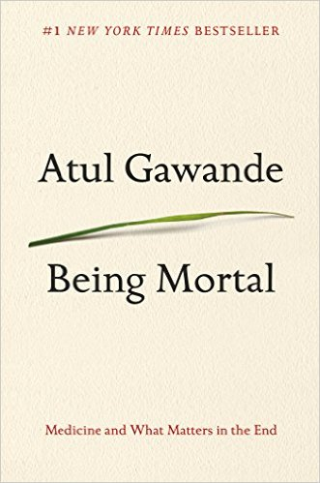
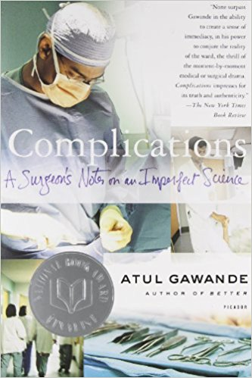
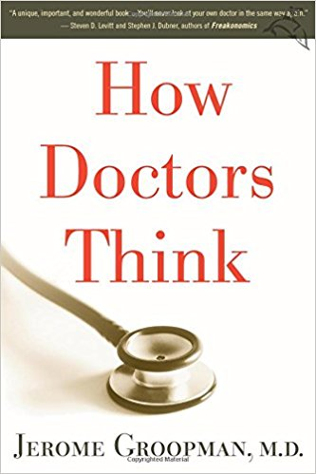
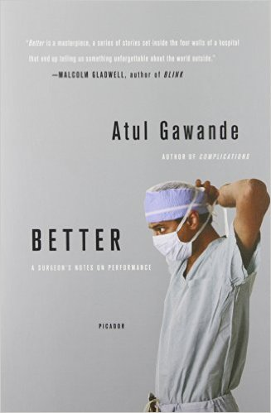
6. Read-Medical Humanism
Notes:
Read. Some ideas- Abraham Verghese, Atul Gawande, Jerome Groopman, Sherwin Nuland among others, to maintain your humanism perspective.
Consider a medical humanism book club…
Discussion: Does anyone have other favorites?

Slide 15
7. Mitigate Unconscious/Implicit Bias
Notes:
Identify your Bias. Malcom Gladwell’s book Blink¹⁰ discussed the concept of implicit, or unconscious bias, as a determinant in our decision-making.
Think about this image-when I say “peanut butter”, you think “jelly”. It’s not a conscious value judgment, but it’s an automatic (unconscious) association.
While nearly all of us would deny conscious feelings of bias or racism, the majority of people, including physicians, hold unconscious attitudes about social groups. These unconscious attitudes develop over time through exposure to media, advertising, life experiences and cultural messages and stereotyping.
In turn, unconscious bias influences our behaviors. In physicians, implicit bias is associated with clinical decision-making.
Implicit bias in physicians has been associated with decreased patient satisfaction, and with disparities in providing analgesia to patients (pediatric and adult), appropriate care for ACS based on racial/ethnic group, and referral for knee arthroplasty based on gender. ¹²

Slide 16
Implicit.Harvard.edu
Notes:
Another way to be a more humanistic physician, to decrease judgment and improve care, is to mitigate our unconscious biases. The first step toward change is identification of bias. The Implicit Associate Test,¹¹ created by Harvard psychologists, is a quick online tool to measure implicit attitudes across a variety of domains. It measures the strength of associations between social groups and positive and negative characteristics, as a reflection of unconscious bias for/against these groups. There are a number of IATs available on the website, eg Race, Arab-Muslim, Gender, Weight, Sexuality, etc.

Slide 17
Mitigating Unconscious Bias
Positive Exemplars
Individuating
Perspective-Taking
Physicians and Implicit Bias: How Doctors May Unwittingly Perpetuate Health Care Disparities. Chapman EN. J Gen Intern Med 2013.
Notes:
Other strategies to decrease implicit bias include seeking out positive exemplars of a group, either in your personal or professional life in order to change the messages that are being internalized. Individuating means making a conscious effort to focus on specific information about a patient when making clinical decisions, rather than filling in partial information with social category information such as race or gender. Perspective-taking, or the attempt to look at a situation from the patient’s point of view, has also been demonstrated to lead to less biased care.¹²

Slide 18
Reflections on June III Assignments
Complete an Implicit Association Test
View NYT video series (x6) ”Peanut Butter, Jelly and racism”
Read “How to be a real EP – advice for new graduates”. Roberts, Emergency Medicine News. 2016.
Read “Reflections about burnout”. Chisholm, AEM. 2009
Notes:
The first two June III assignments were meant to provoke consideration of how implicit/unconscious bias may impact our occupational wellness and affect our relationships with patients. Did anyone complete either of these and/or have thoughts about the topic of implicit bias?
The second two assignments are commentary written/curated by 2 icons in Emergency Medicine-Jim Roberts, of Roberts and Hedges, Vice Chair at Drexel in Philadelphia, and Carey Chisholm, former PD at University of Indiana. Any thoughts on their advice about success and burnout? If you haven’t had the chance yet, we encourage you to read these high impact essays this month.

Slide 19
Conclusions: The System
Reclaim autonomy and control of your workplace
Involvement in operations, QI, hospital committees to effect change
Notes:
Occupational Wellness Concepts and Conclusions.
Change the System

Slide 20
Conclusions: Get Personal
Compassion Role Models
Your patients are not the enemy
Seek connection with your patients, your colleagues
Foster Social Resilience-embrace your tribe
Develop a Growth Mindset
Read-medical humanism
Identify/Mitigate your Bias
Notes:
Occupational Wellness Concepts and Conclusions.
Building occupational wellness involves seeking connection with your patients and colleagues, building empathy, learning to share stories, and developing resilience to deal in a healthy way with medical error, loss, and stress. Learn from authors and senior clinicians who are well into this journey, and from friends and trainees who are just starting out. Foster Social Resilience and a Growth Mindset. Identify and mitigate your implicit bias and judgment. Engage with your medical system to build autonomy and a sense of value. Through “work-life integration,” create a lifelong approach to self-care, sustained joy and satisfaction as an emergency physician.

Slide 21
Looking Ahead

Slide 22
EMERA.network.org
Notes:
Coming up in September-Physical Wellness!

Slide 23
Individualized Interactive Instruction (III) Assignments: (to be completed in August)
Sleep Journal: Utilize one of these apps for two weeks in August. Reflect on your sleep satisfaction and plan to discuss your experience with sleep during residency (one hour credit)
iPhone: Sleep Diary
Android: SleepBot - Sleep Cycle
Commit to a primary care doctor/dentist and seem them for a health evaluation if not completed in the past year. (one hour credit)
Notes:
Residents, please complete these III assignments in August as preparation for September’s lecture.
Suggestions:
--Check to see if your institutions have a list of preferred medical providers for resident physicians.
--Summer is a great time for shared fitness. Consider promoting a short end of summer run/walk/obstacle course event for residents to participate in together: train for it now ☺
--Consider bringing in healthier snacks to conference over the next 2 months…and beyond
The Advocate GME office is compiling a list of IM/FM/Peds/OB Gyn/Mental Health providers in their teaching and affiliated faculty who specifically have volunteered to care for resident physicians and their families, understanding the scheduling issues for residents, and appreciating the sensitivities of caring for physicians.
Advocate residents-have you signed up for the Chicago Super Sprint Tri on Saturday August 26?

Slide 24
Ian Maclaren
Notes:
End.
(Rev. John Watson, known by his pen name Ian Maclaren, was a Scottish author and theologian)

Slide 25
References
1. Shanafelt TD, Hasan O, Dyrbye LN, et al. Changes in burnout and satisfaction with work-life balance in physicians and the general US working population between 2011 and 2014. Mayo Clin Proc. 2015;90:1600-1613.
2. Medscape Lifestyle Report 2017: Race and Ethnicity, Bias and Burnout
3. National Wellness Institute http://www.nationalwellness.org/?page=Six_Dimensions
4. The Missing Link: Connection Is the Key to Resilience in Medical Education. McKenna KM, Hashimoto DA, Maguire MS, Bynum WE. Acad Med 2016;91:1197-1199.
5. To be or not to be empathic: the combined role of empathic concern and perspective taking in understanding burnout in general practice. Lamothe M, Boujut E, Zenasni F, Sultan S. BMC Family Practice 2014, 15:15.
6. Shem, Samuel. The House of God. New York City, NY: Random House, Inc., 1978.
7. Wisdom in Medicine: What Helps Physicians After a Medical Error? Plews-Ogan M et al. Acad Med 2016;91:233-241.
8. Association of Perceived Medical Errors with Resident Distress and Empathy. A Prospective Longitudinal Study. West CP, Huschka MM, Novotny PJ, Sloan JA, Kolars JC, Habermann TM, Shanafelt TD. JAMA 2006;296:1071-1078.
9. Dweck, Carol. Mindset: The New Psychology of Success. New York City, NY: Ballantine Books, 2006.
10. Gladwell, Malcolm. Blink: The Power of Thinking Without Thinking. New York City, NY: Little, Brown and Company, 2005.
11. Project Implicit https://implicit.harvard.edu/implicit/takeatest.html
12. Physicians and Implicit Bias: How Doctors May Unwittingly Perpetuate Health Care Disparities. Chapman EN, Kaatz A, Carnes M. J Gen Intern Med 2013;28(11):1504-10.

